Slide 1

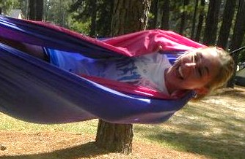
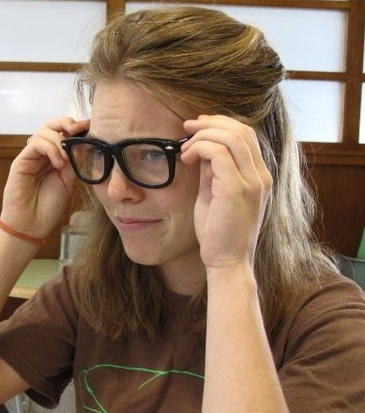
The power of suggestion
By:
Aaron
C o u r t n e y
An experiment to test people’s unconscious response to grammatical suggestions.
Emma

Slide 2
Hypothesis:
When given a choice of colors, people are more likely to choose the “suggested” one, a color that’s capitalized in the question prompt.
Considerations:
Is capitalization too subtle or too obvious? Does age and/or gender affect a person’s openness to these suggestions?

Slide 3
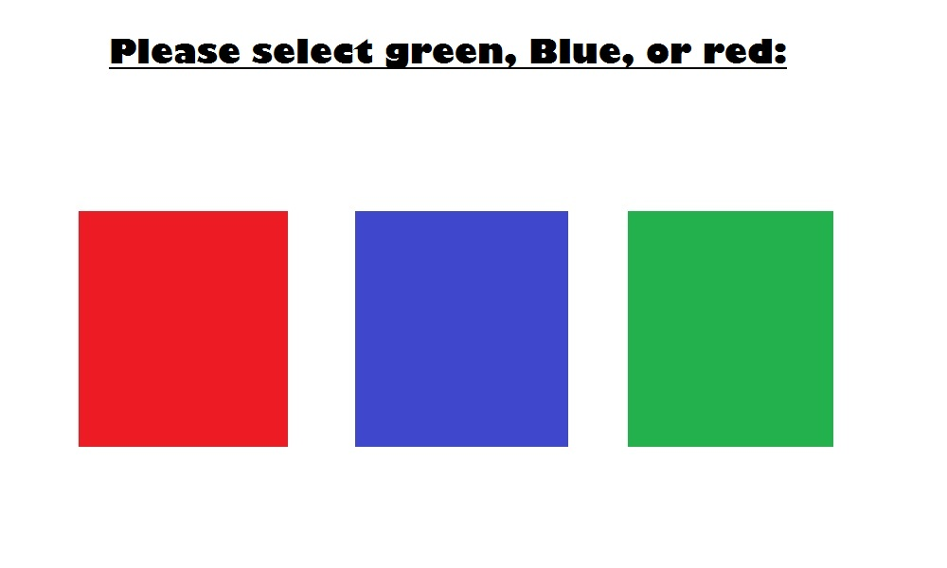
Experimental methodology
To test our hypothesis, each team member was assigned a color with which to survey random people. For the function corresponding to that color, the color name was capitalized in the display.
Example of “testBlue” function display:

Slide 4
Experimental Methodology Continued…
We asked diverse groups of people, from relatives at Thanksgiving dinner to students studying at Starbucks, to take our “survey”.
Each survey asked for the participant’s gender, age, and for them to choose a color out of the three choices displayed.
One problem we ran into was perhaps not finding enough older folks – most of our participants were 18-22 years old.
Another difficulty was the fact that some people did not seem to actually read the display caption…

Slide 5
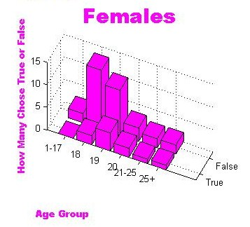
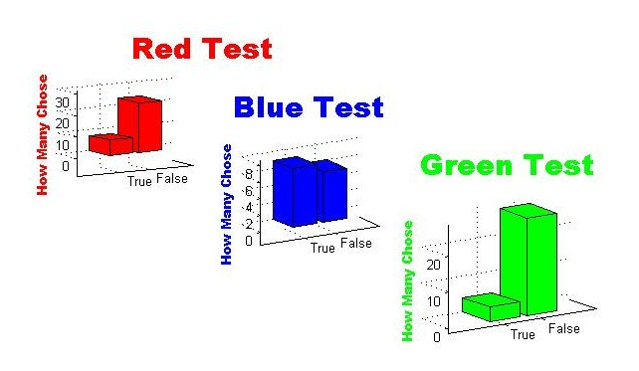
Sample data
One of the things we did with our data was to compare the number of people that answered “True” or “False” (chose the capitalized color or not) with respect to their gender and age. The graph at left shows the graph for female participants. As seen at left, there were many more False than True answers. Also, we did not notice much of a difference between male and female participants.
We also created graphs for each individual color test, seeing how many participants for that test chose the suggested color.

Slide 6
Data analysis
Some interesting things we noted:
There was not a much variation between male and female answers.
Blue was chosen far more frequently than either of the other two colors, possibly because it was displayed in the center.
The number of blues chosen actually changed the overall proportion to be even less than random selection, suggesting that placement actually has more impact on choice than our grammatical “suggestion”.

Slide 7
Conclusions
Perhaps a different way of “suggesting” colors would have worked better, such as positioning the colors differently or capitalizing the entire word (e.g. “red, BLUE, or green”).
Unfortunately, the people randomly surveyed did not often choose the capitalized color, so it is hard to draw conclusions about the correlations between gender, age, and openness to suggestions.
As far as we can tell, subtly suggesting a color with one capital letter had little influence on people’s decisions.

